Slide 1
SINGLY REINFORCED BEAMS
Submitted By-
NAME | Bhaveeth Singh | Ishpreet Kaur | Jaskaran Singh
URN | 2104022 | 2104030 | 2104033
CRN | 2014106 | 2014111 | 2014113

Slide 2
Introduction
A singly reinforced beam is a structural element commonly used in construction, particularly in buildings and bridges. The term "singly reinforced" refers to the fact that the reinforcement in the beam is provided only on one face, typically on the tension side. This reinforcement is added to enhance the beam's ability to resist tensile forces, which are forces that tend to stretch or pull apart the material.
Working Principle:
Tensile forces in the beam are resisted by the reinforcement, preventing the development of cracks and ensuring the overall structural integrity.
The neutral axis is a key factor in understanding how these forces are distributed within the beam.
Design Considerations:
The design of singly reinforced beams takes into account factors such as applied loads, material properties, safety considerations, and the desired structural performance.
Limit State Design:
The design philosophy involves evaluating the beam's performance under different limit states, including serviceability (deflection, cracking) and ultimate limit states (failure).
Stress-Strain Relationship:
The stress-strain relationship of concrete and steel is crucial in understanding how these materials behave under various loads.

Slide 3
Types of Reinforcements in Beams
In singly reinforced beams, the primary reinforcement is typically provided on the tension side to resist tensile forces. The choice of reinforcement in these beams is crucial for ensuring structural stability and performance. The most common types of reinforcements used in singly reinforced beams include:
Tension Reinforcement (Bottom Reinforcement)
Compression Reinforcement (Optional)
Stirrups (Shear Reinforcement)
Link Reinforcement
The primary focus in singly reinforced beams is on the bottom tension reinforcement, as this is where the concrete is most vulnerable to cracking and failure under tensile loads. The amount and placement of reinforcement are determined through structural analysis and design considerations, taking into account factors such as applied loads, material properties, and safety requirements. It's essential to adhere to proper detailing and construction practices to ensure the effectiveness of the reinforcement in singly reinforced beams.

Slide 4
Limit state method of design of singly reinforced beams
The Limit State Method is a widely used approach for the design of reinforced concrete structures, including singly reinforced beams. It is based on the concept of assessing the performance of a structure under different limit states, ensuring safety and serviceability throughout its life. The two main limit states considered in the design of singly reinforced beams are the Serviceability Limit State (SLS) and the Ultimate Limit State (ULS).
1. Serviceability Limit State (SLS):
At the serviceability limit state, the focus is on ensuring that the structure performs acceptably under normal service loads. Key considerations include deflection, cracking, and durability. The following steps are involved in the design of singly reinforced beams at the SLS:
Deflection Control: Calculate and check deflections to ensure they are within acceptable limits. This is important for preventing excessive deformations that may affect the appearance, functionality, or comfort of the structure.
Crack Control: Assess cracking in the structure. Ensure that the cracks that form are within permissible limits to maintain durability and aesthetic appearance. Adequate reinforcement is provided to control crack widths.

Slide 5
2. Ultimate Limit State (ULS):
At the ultimate limit state, the focus is on ensuring that the structure can safely carry the maximum loads without collapsing. The design should prevent structural failure under extreme conditions. The following steps are involved in the design of singly reinforced beams at the ULS:
Calculate Factored Loads: Determine the factored loads on the beam considering appropriate load combinations, including dead loads, live loads, and other applicable loads.
Calculate Moments and Shears: Use structural analysis methods to calculate the moments and shears in the beam due to the factored loads.
Determine Moment of Resistance: Calculate the moment of resistance of the beam using the design strength of concrete and the tensile strength of the reinforcement.
Check for Adequate Reinforcement: Verify that the amount of reinforcement provided is sufficient to resist the calculated moments. This involves checking the reinforcement ratio against the specified limits.
Shear Reinforcement: Ensure that the shear forces are adequately resisted by providing shear reinforcement, typically in the form of stirrups.
Check for Development Length: Verify that the development length of the reinforcing bars is sufficient to develop the full strength of the bars.
Check for Anchorage: Ensure that proper anchorage is provided to prevent the reinforcement from slipping.

Slide 6
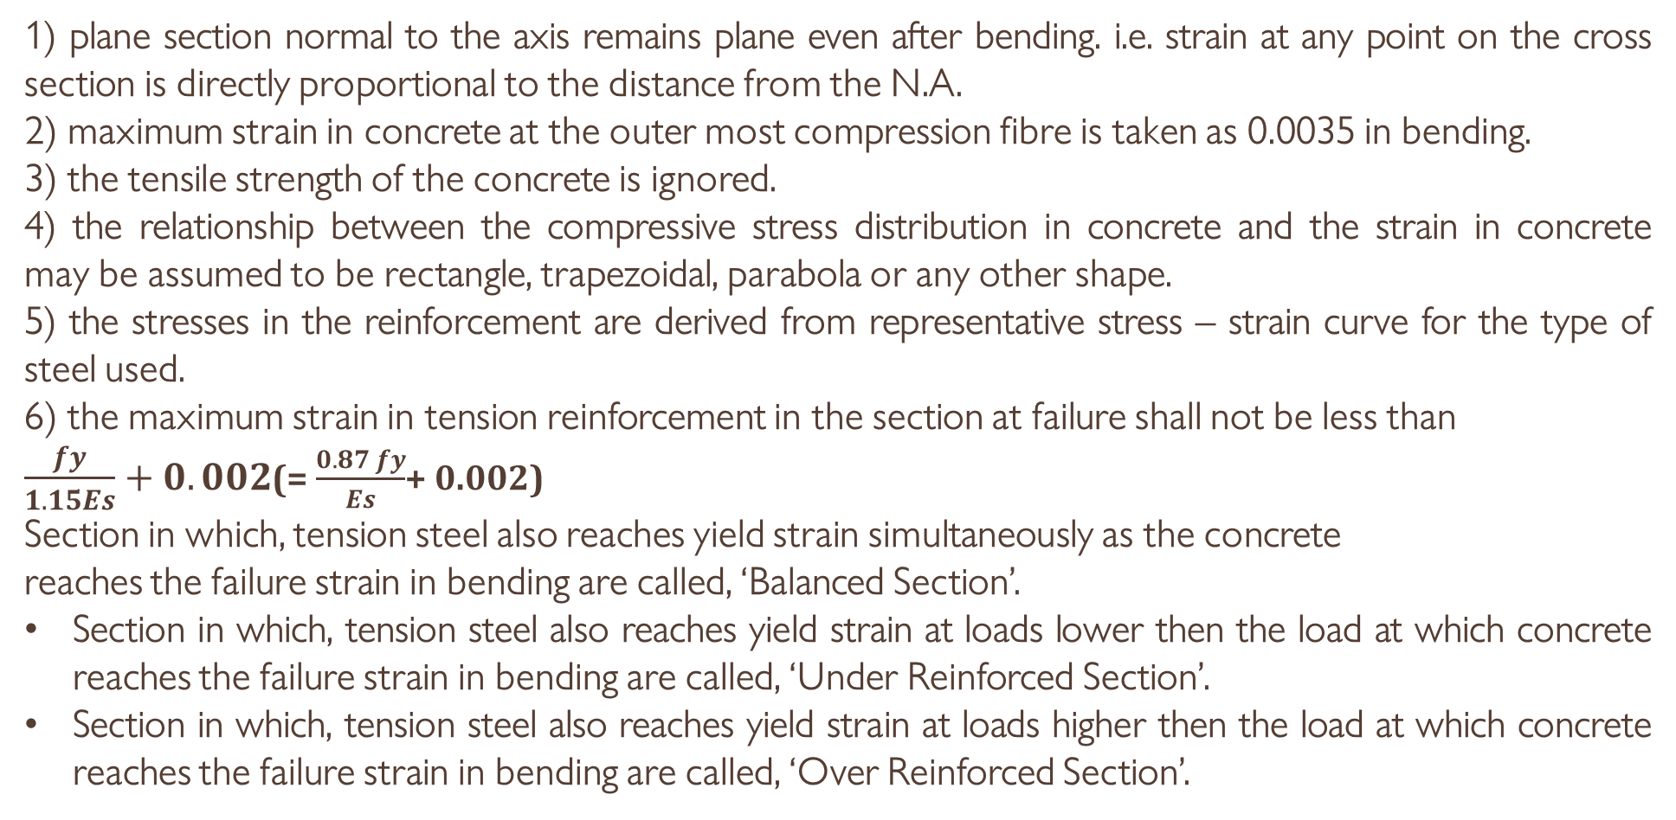
Assumptions for Limit State of Collapse (Flexure): IS:456-2000 [cl. 38.1 p-69]
1) plane section normal to the axis remains plane even after bending. i.e. strain at any point on the cross section is directly proportional to the distance from the N.A.
2) maximum strain in concrete at the outer most compression fibre is taken as 0.0035 in bending.
3) the tensile strength of the concrete is ignored.
4) the relationship between the compressive stress distribution in concrete and the strain in concrete may be assumed to be rectangle, trapezoidal, parabola or any other shape.
5) the stresses in the reinforcement are derived from representative stress – strain curve for the type of steel used.
6) the maximum strain in tension reinforcement in the section at failure shall not be less than
$\frac{fy}{1.15Es}+0.002$(= $\frac{0.87 fy}{Es}$+ 0.002)
Section in which, tension steel also reaches yield strain simultaneously as the concrete
reaches the failure strain in bending are called, ‘Balanced Section’.
Section in which, tension steel also reaches yield strain at loads lower then the load at which concrete reaches the failure strain in bending are called, ‘Under Reinforced Section’.
Section in which, tension steel also reaches yield strain at loads higher then the load at which concrete reaches the failure strain in bending are called, ‘Over Reinforced Section’.

Slide 7
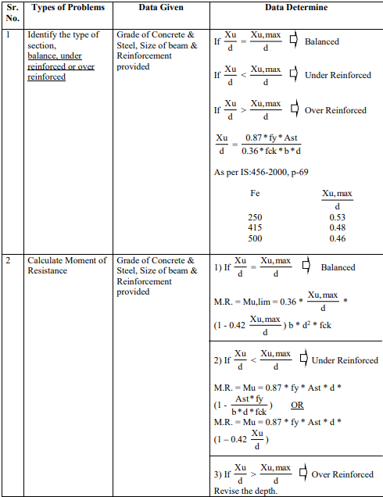
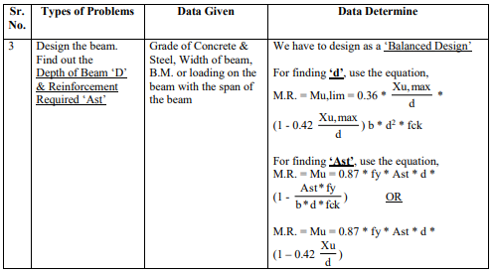
According to IS:456-2000
Where,
d = effective depth of beam in mm
b = width of beam in mm
Xu = depth of actual neutral axis in mm from extreme compression fibre
Xu,max = depth of critical neutral axis in mm from extreme compression fibre
Ast = area of tensile reinforcement
fck = characteristic compressive strength of concrete in Mpa
fy = characteristic strength of steel in MPa
Mu,lim = limiting M.R. of a section without compression reinforcement

Slide 8
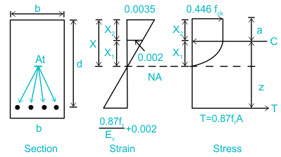
STRESS BLOCK PARAMETERS

Slide 9
Various steps involved in the design of beams are as follows:-
Step 1- Calculate the intensity of the load projected to act on the beam in the first stage. This can be determined by adding the transferable loads which are expected to act upon the beam. Determine the clear span of the beam to be designed using the drawings provided.
Step 2- Determine the effective span of the beam in the next step. The effective span of various beams can be calculated as follows:-
(a) Simply Supported Beams- For the design of simply supported beams the effective span is calculated as the minimum of the following:
Clear span plus beam or slab effective depth
The centre-to-centre distance between the supports of the simply supported beam.
(b) Cantilever Beams- The effective span of the cantilever beam is calculated as follows:
Overhang length plus half the effective depth.
Except where it forms the end of a continuous beam where the length up to the centre of support is taken.
(c) Continuous Beams- If the width of the supports in a continuous beam or slab is less than 1/12 of the clear span, the effective span is calculated as in (a). If the width of the support exceeds 1/12 of the clear span or 600mm, whichever is less, the effective span is calculated as follows:
For the end span with one end fixed and the other continuous or for intermediate spans, the effective span shall be the clear span between the supports.
For the end span with one end free and the other continuous, the effective span shall be equal to the clear span plus half the effective depth of the beam or slab or clear span plus half the width of discontinuous support, whichever is less.

Slide 10
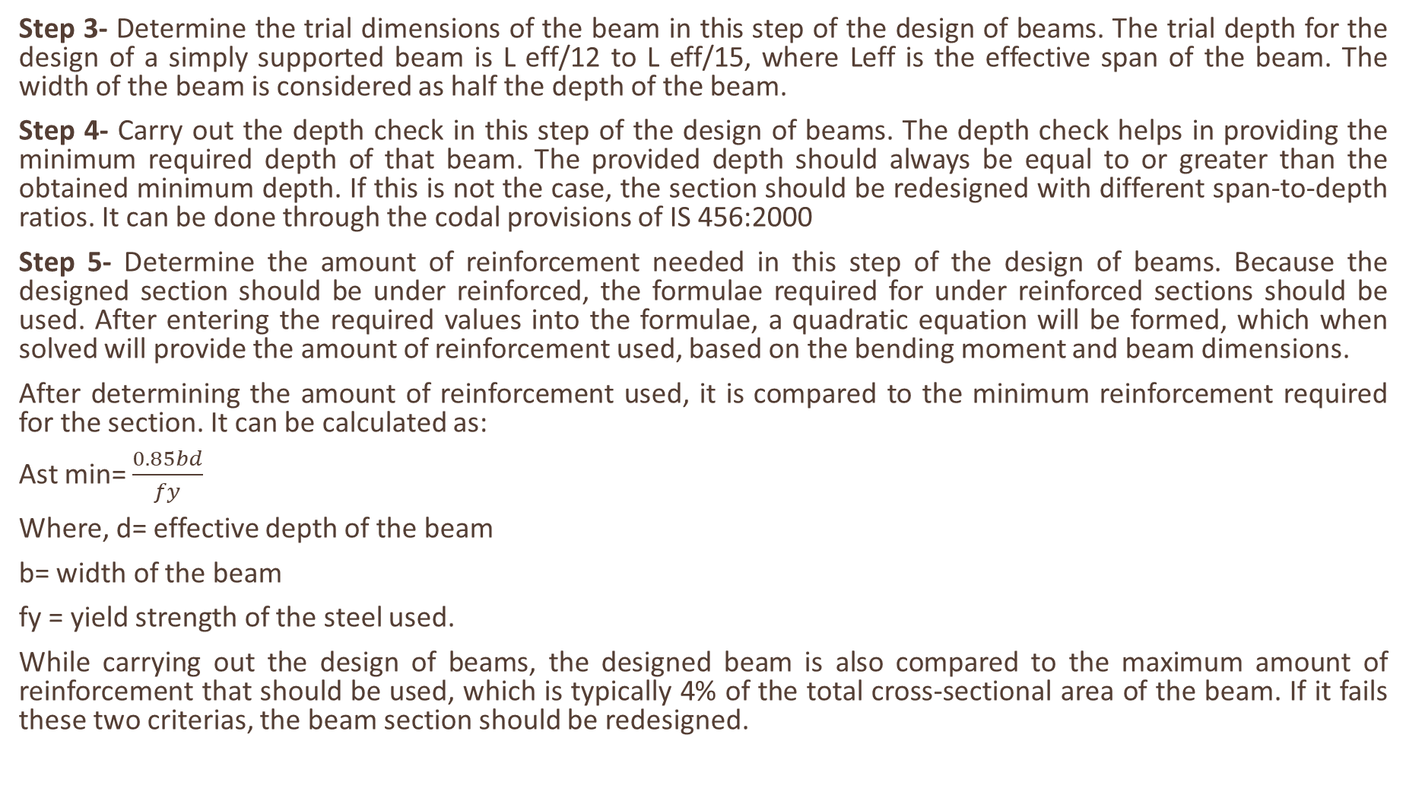
Step 3- Determine the trial dimensions of the beam in this step of the design of beams. The trial depth for the design of a simply supported beam is L eff/12 to L eff/15, where Leff is the effective span of the beam. The width of the beam is considered as half the depth of the beam.
Step 4- Carry out the depth check in this step of the design of beams. The depth check helps in providing the minimum required depth of that beam. The provided depth should always be equal to or greater than the obtained minimum depth. If this is not the case, the section should be redesigned with different span-to-depth ratios. It can be done through the codal provisions of IS 456:2000
Step 5- Determine the amount of reinforcement needed in this step of the design of beams. Because the designed section should be under reinforced, the formulae required for under reinforced sections should be used. After entering the required values into the formulae, a quadratic equation will be formed, which when solved will provide the amount of reinforcement used, based on the bending moment and beam dimensions.
After determining the amount of reinforcement used, it is compared to the minimum reinforcement required for the section. It can be calculated as:
Ast min= $\frac{0.85bd}{fy}$
Where, d= effective depth of the beam
b= width of the beam
fy = yield strength of the steel used.
While carrying out the design of beams, the designed beam is also compared to the maximum amount of reinforcement that should be used, which is typically 4% of the total cross-sectional area of the beam. If it fails these two criterias, the beam section should be redesigned.

Slide 11
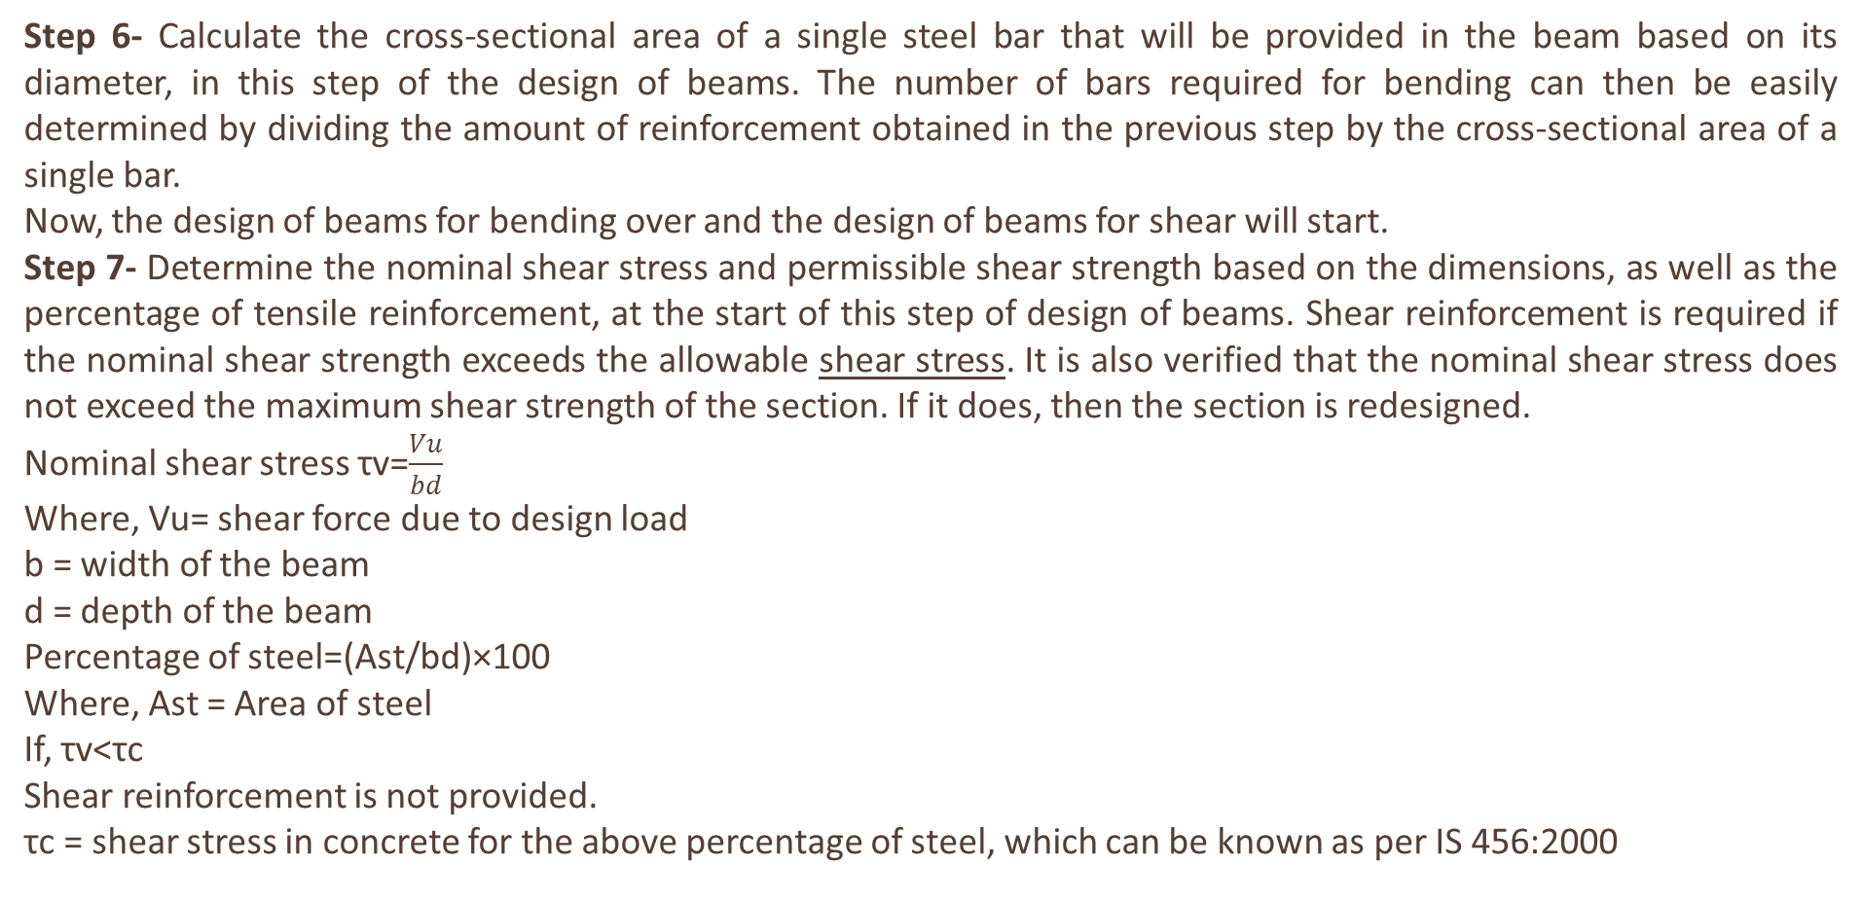
Step 6- Calculate the cross-sectional area of a single steel bar that will be provided in the beam based on its diameter, in this step of the design of beams. The number of bars required for bending can then be easily determined by dividing the amount of reinforcement obtained in the previous step by the cross-sectional area of a single bar.
Now, the design of beams for bending over and the design of beams for shear will start.
Step 7- Determine the nominal shear stress and permissible shear strength based on the dimensions, as well as the percentage of tensile reinforcement, at the start of this step of design of beams. Shear reinforcement is required if the nominal shear strength exceeds the allowable shear stress. It is also verified that the nominal shear stress does not exceed the maximum shear strength of the section. If it does, then the section is redesigned.
Nominal shear stress τv=$\frac{Vu}{bd}$
Where, Vu= shear force due to design load
b = width of the beam
d = depth of the beam
Percentage of steel=(Ast/bd)×100
Where, Ast = Area of steel
If, τv<τc
Shear reinforcement is not provided.
τc = shear stress in concrete for the above percentage of steel, which can be known as per IS 456:2000

Slide 12
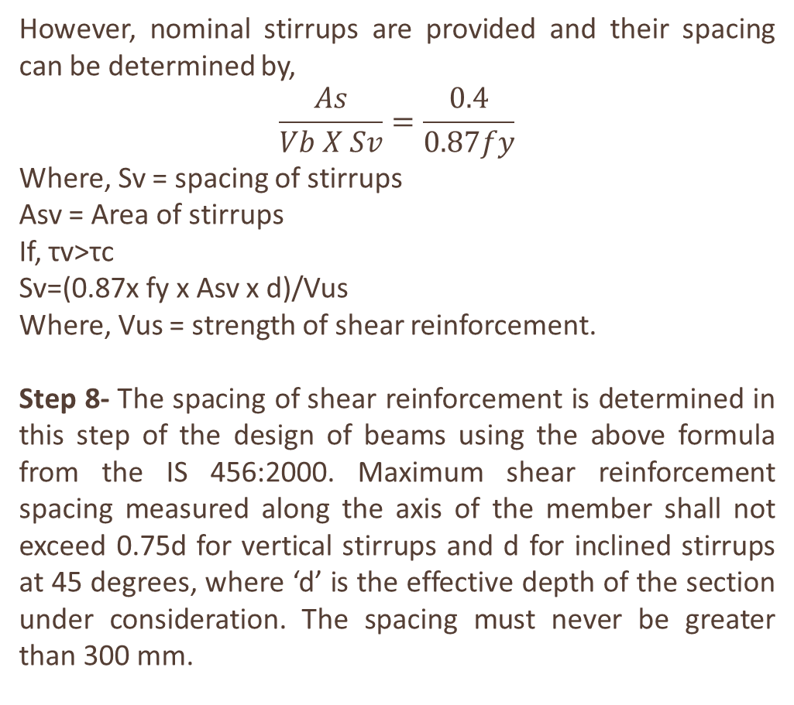
However, nominal stirrups are provided and their spacing can be determined by,
$$\frac{As}{Vb X Sv}=\frac{0.4}{0.87fy}$$
Where, Sv = spacing of stirrups
Asv = Area of stirrups
If, τv>τc
Sv=(0.87x fy x Asv x d)/Vus
Where, Vus = strength of shear reinforcement.
Step 8- The spacing of shear reinforcement is determined in this step of the design of beams using the above formula from the IS 456:2000. Maximum shear reinforcement spacing measured along the axis of the member shall not exceed 0.75d for vertical stirrups and d for inclined stirrups at 45 degrees, where ‘d’ is the effective depth of the section under consideration. The spacing must never be greater than 300 mm.

Slide 13
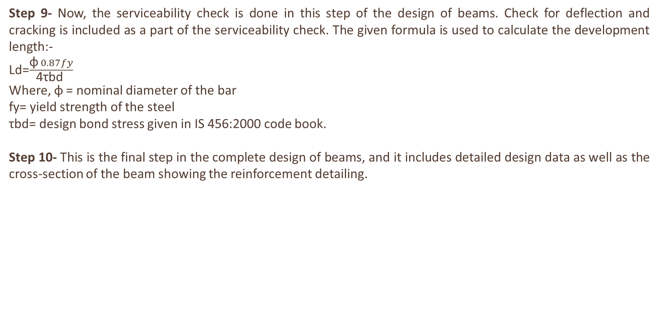
Step 9- Now, the serviceability check is done in this step of the design of beams. Check for deflection and cracking is included as a part of the serviceability check. The given formula is used to calculate the development length:-
Ld=$\frac{\text{ϕ} 0.87fy}{\text{4}\text{τbd} }$
Where, ϕ = nominal diameter of the bar
fy= yield strength of the steel
τbd= design bond stress given in IS 456:2000 code book.
Step 10- This is the final step in the complete design of beams, and it includes detailed design data as well as the cross-section of the beam showing the reinforcement detailing.

Slide 14
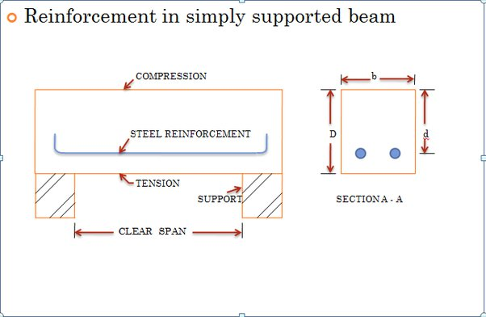

Slide 15
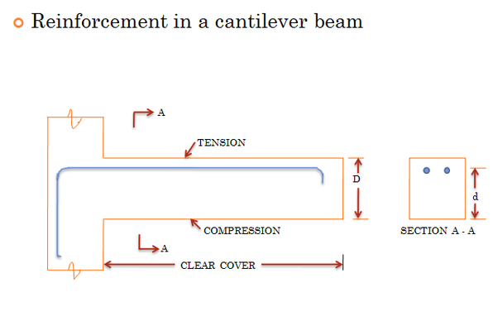

Slide 16
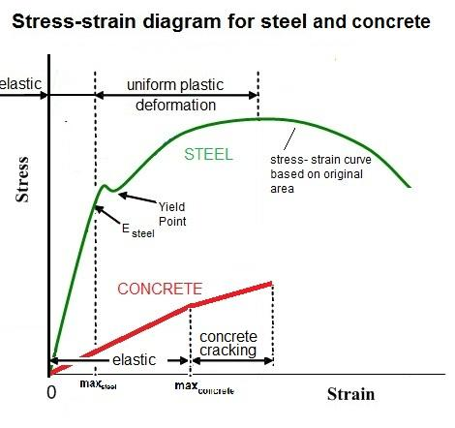

Slide 17
THANK YOU!

